Slide 1
Special Numbers

Slide 2
Contents
Stirling Numbers
Eulerian Numbers
Harmonic Numbers
Harmonic Summation
Bernoulli Numbers
Fibonacci Numbers

Slide 3
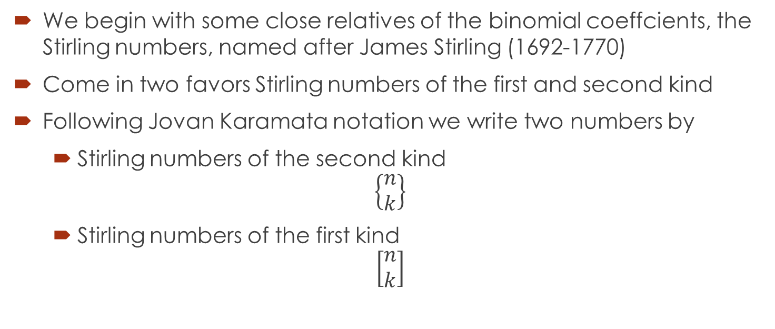
Striling Numbers
We begin with some close relatives of the binomial coeffcients, the Stirling numbers, named after James Stirling (1692-1770)
Come in two favors Stirling numbers of the first and second kind
Following Jovan Karamata notation we write two numbers by
Stirling numbers of the second kind
$$\left\{\begin{matrix}n \\ k\end{matrix}\right\}$$
Stirling numbers of the first kind
$$\left[\begin{matrix}n \\ k\end{matrix}\right]$$

Slide 4
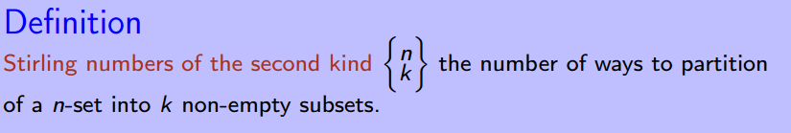
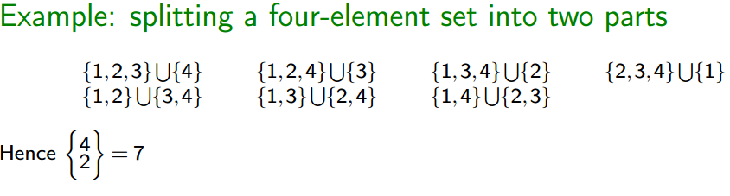
Stirling numbers of the second kind
For example, The set {1,2,3} can be partitioned into
three subsets in one way: {{1},{2},{3}};
into two subsets in three ways: {{1,2},{3}}, {{1,3},{2}}, and {{1},{2,3}}; and
into one subset in one way: {{1,2,3}}.

Slide 5
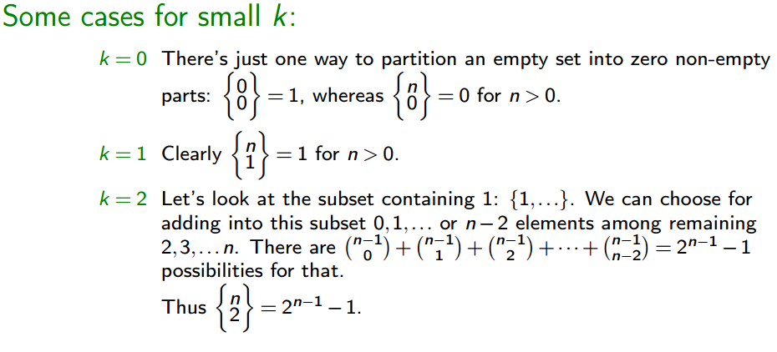
Cont.…..

Slide 6
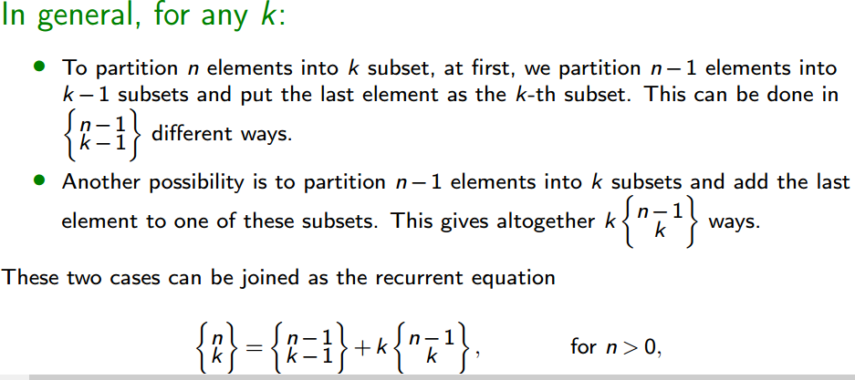
Cont.…

Slide 7
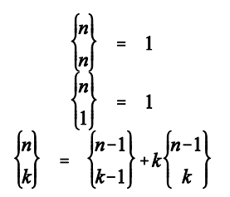
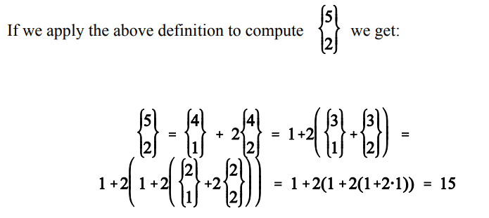
Cont.…
As always we need initial conditions to halt the recursion. This gives us the full recursion:

Slide 8
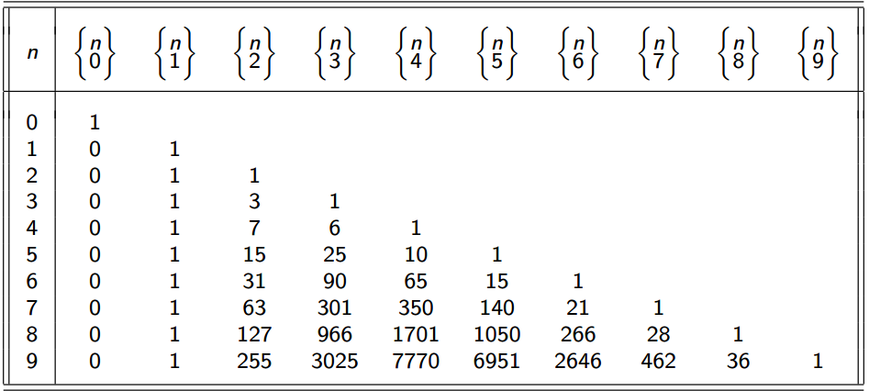
Cant….
Stirling’s triangle for subsets

Slide 9

Exercise
Compute the Striling number of second kind for $\left\{\begin{matrix}12 \\ 11\end{matrix}\right\}$

Slide 10
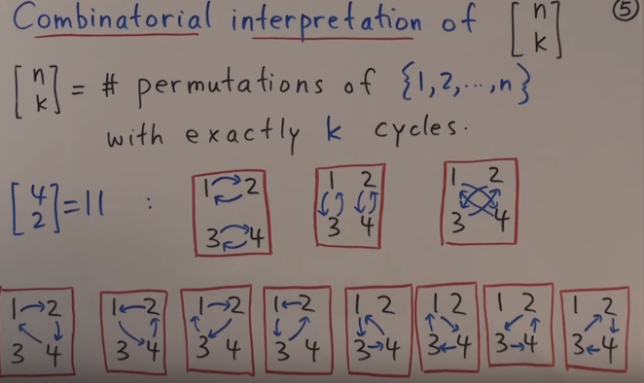
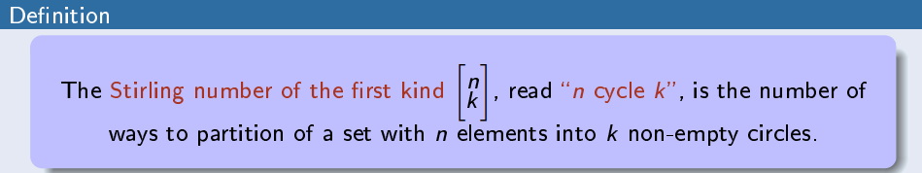
Stirling numbers of the first kind
Notes:
People: we place one people to another, then another and so on.

Slide 11
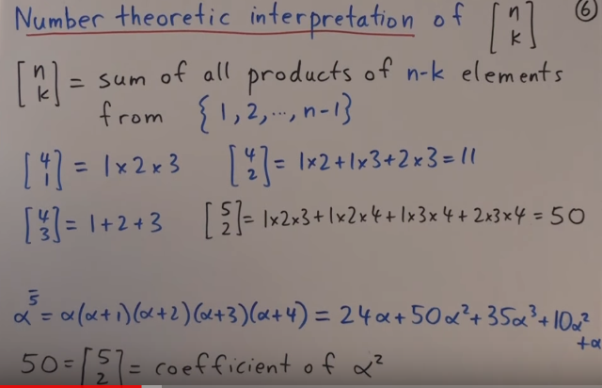
Cont.…

Slide 12
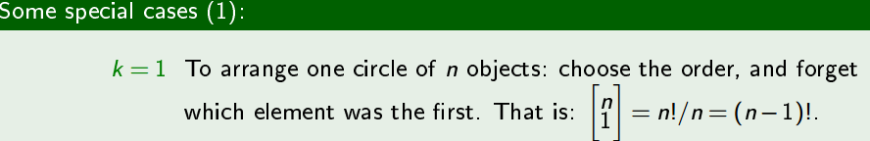
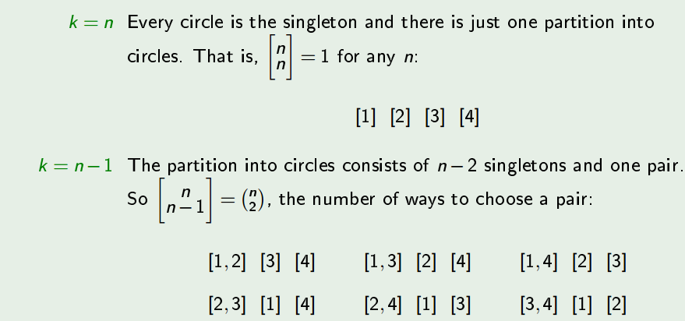
Cont.….

Slide 13
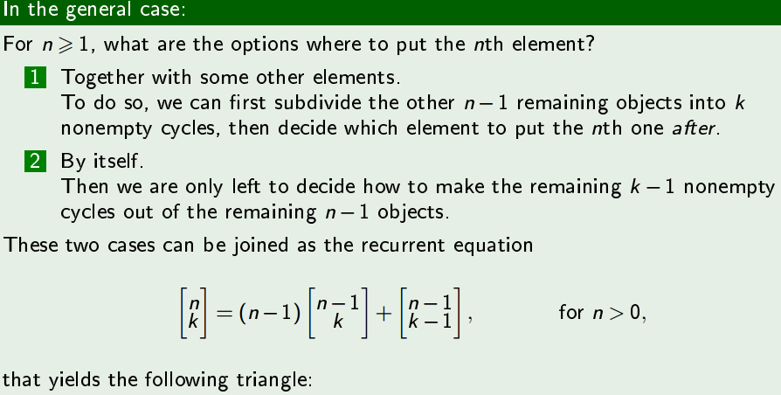
Cant….

Slide 14
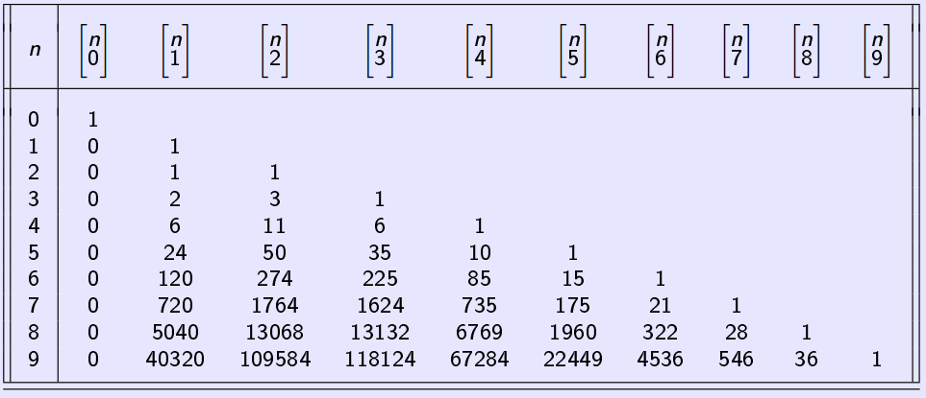
Stirling's triangle for circles

Slide 15
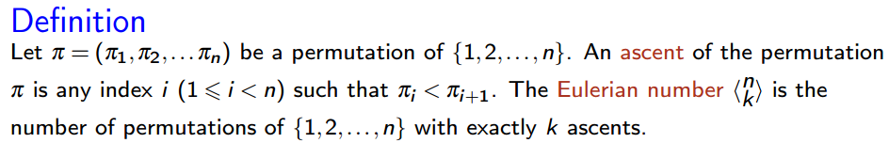
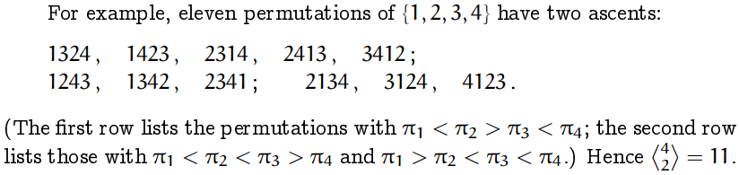
Eulerian Numbers

Slide 16
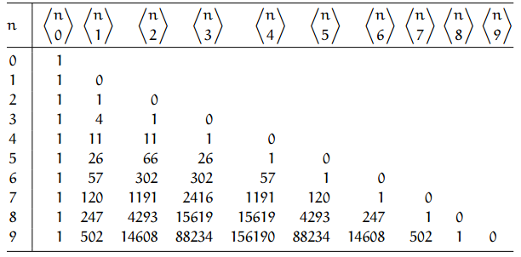
Euler's triangle

Slide 17
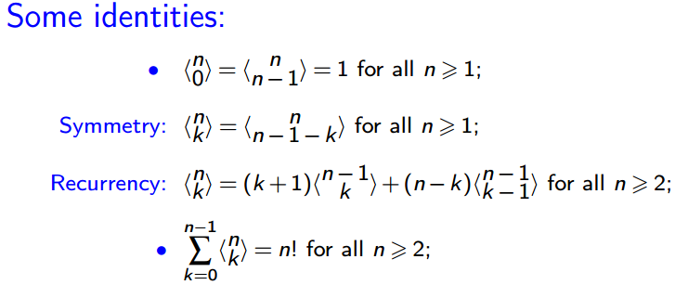
Cont.…

Slide 18
References
https://www.youtube.com/watch?v=LB68I4mkb8Y

